Slide 1


Slide 2
Objectives
Evaluate overall company health
Gain insights into revenue streams
Compare changes from previous periods

Slide 3
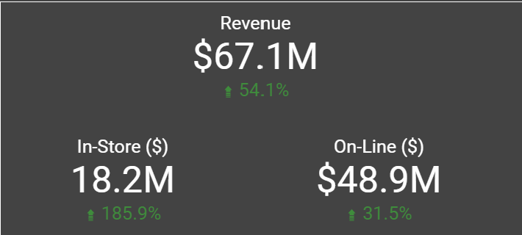
Let’s look at the revenue KPIs

Slide 4
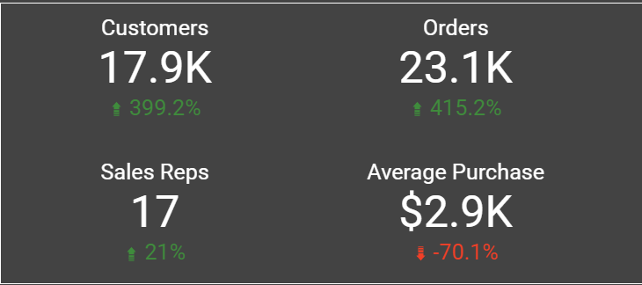
Here are some general numbers

Slide 5
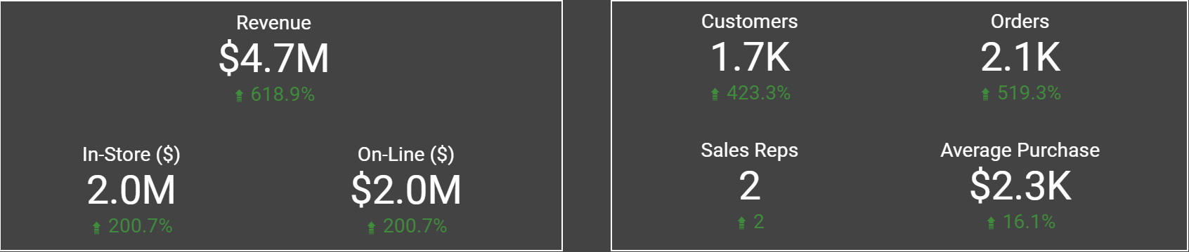
Zooming in on Germany
Highest increase of all countries
New sales reps

Slide 6
The other side of the coin
US and Canada
Orders are up 396% and 647%
Revenue is only up 24% and 13%
No change in the sales force

Slide 7
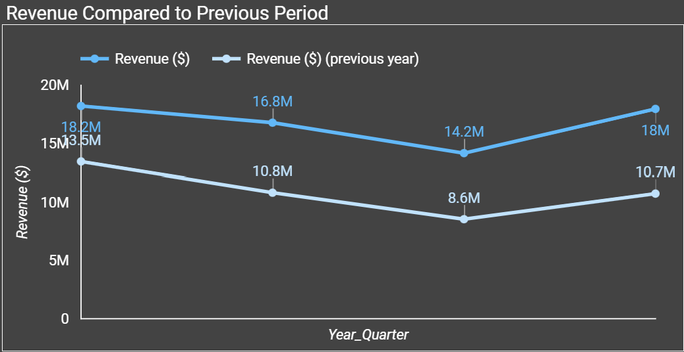
Comparing Revenue YoY

Slide 8
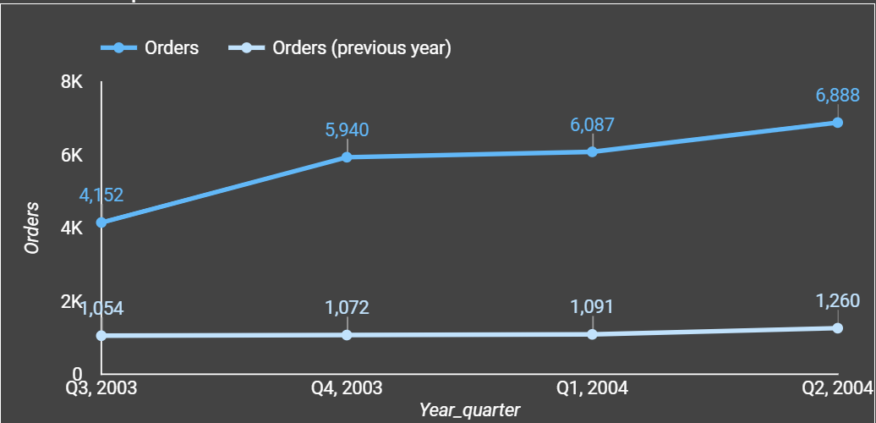
Comparing Orders YoY

Slide 9
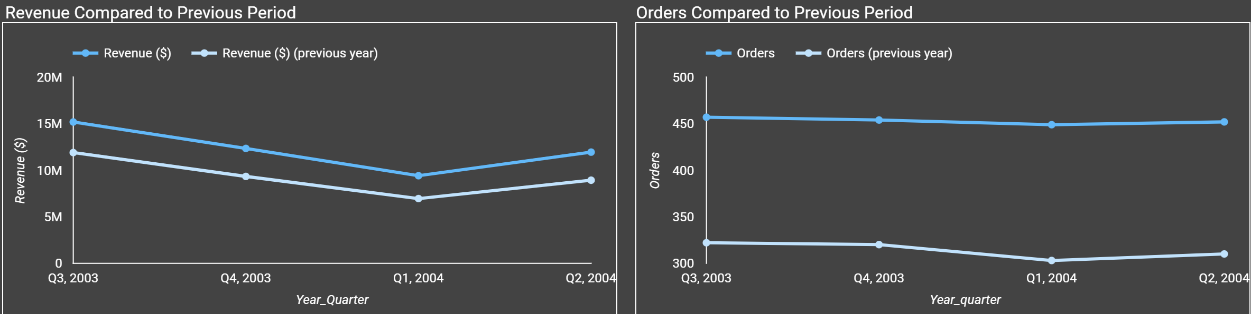
Taking a closer look at In-Store Sales

Slide 10
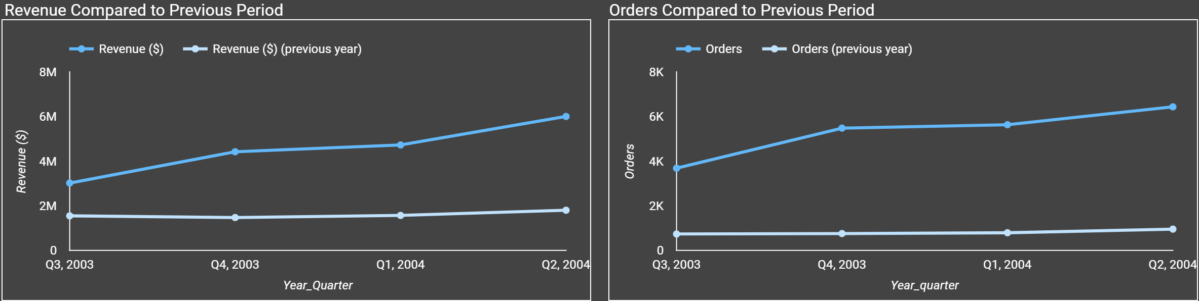
…and On-Line Sales

Slide 11
Conclusion
Over the last 4 quarters:
54% revenue growth
21% increase in Sales Reps
Almost 400% more customers

Slide 12
Recommendations
Increase sales force in Germany
Possibly expand salespeople into more countries
Expand sales of big-ticket items in the US and Canada
Conduct further analysis of pricing and marketing campaigns

